Slide 1
Drunken Sailor
By: Anton Reunovs, Carlos Schaap Garcia, Cosmin Buzic, Felix Anghel and Stefan Bryda

Slide 2
Purpose of the App
Helps users quickly find a nearby open bar
Uses live GPS location
Prioritizes bars that are currently open
Makes navigation fun instead of using a standard map

Slide 3
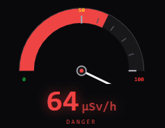
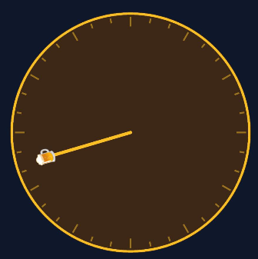
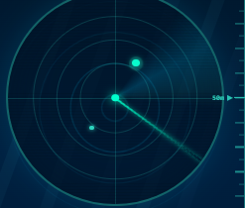
Main Functionalities
Finds the nearest bar based on user location
Checks opening hours automatically
Shows distance to the selected bar
Provides three navigation modes:
Compass
Radar
Nuclear Geiger Counter
Uses vibration feedback based on distance

Slide 4
How it works
Flutter mobile application
Firebase backend to store bar data
GPS provides the user’s current position
Distance and bearing are calculated in the app
Geohash queries help find nearby places efficiently

Slide 5
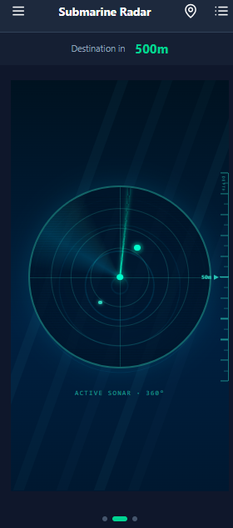
User Interface
Simple navigation with swipeable views
Name of the bar and distance indicator at the top
Menu for switching between modes

Slide 6
Problems faced
Location accuracy
Testing on emulated devices and real devices
Making compass direction reliable

Slide 7

DEMO

Slide 8

Questions?

Slide 9

Thank you for your time!

